Slide 1
SMART CREATURES

Slide 2
Smart Creatures
IOT connects objects & machine to internet.
Living creatures can be connected to internet.
Sensors can be placed on them

Slide 3
Connected cow
Sparked a DUTCH COMPANY developed a sensor placed in cow’s ear.
Sensor monitors health aspect of the cow and location.
Sensor transmit data wirelessly for analysis.
Data is around 200MB in a year.
Data gives complete view of a herd and statistics on every cow.

Slide 4
Connected cow
Environmental effect on cow.
Effect of changed diet.
Early detection of a disease.
Early detection of their pregnancy.

Slide 5
Roaches
Placements of sensors on roaches.
Electronic backpack attached to the roaches.
Electronic back pack uses wireless communication to a controller and can be “driven” remotely.
Roaches with electronic backpack can be kept in the disaster area.
Use of roaches help to rescue survivors in the disaster.

Slide 6
Electronic Backpack
Electronic backpack is equipped with directional microphones. That can detect certain sounds and its direction.
Software can analyze, sound is coming from person and not from leaking pipes, etc.
IOT often goes beyond just adding sensors and more intelligence to non-living “things”.
Living “things” can also be connected to the internet & create wonders.

Slide 7
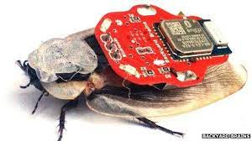
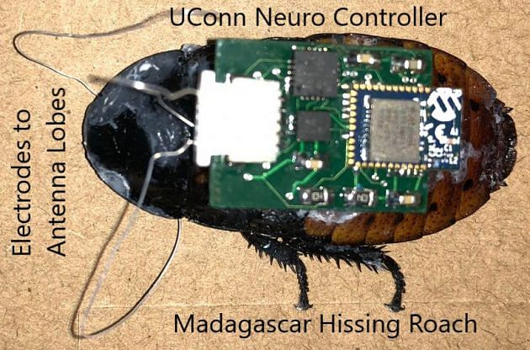
Roaches

Slide 8
IOT and DIGITASATION
INTERNET OF THINGS

Slide 9
DIGITIZATION
IOT provide connectivity to the physical object
Physical object can share information with physical world through internet
Physical objects needs sensors, actuators ,controllers to do the above task
Actuators are finally connected with physical world
ALL ABOVE DATA FLOW IS POSSIBLE ONLY DUE TO DIGITIZATION
DIGITISATION BRINGS TOGETHER “THINGS”, “DATA”, “BUSINESS PROCESS”
TO MAKE NETWORK CONNECTION VALUABLE

Slide 10
DIGITIZATION
sensors
ADC
CONTROLLER
DAC
ACTUATORS

Slide 11
BENEFITS of DIGITZATION
It acts as differentiator
IOT acts as prime enabler of digitization
Smart objects connectivity will increase due to digitization
Digitization and IOT increasing…
Relevancy
Value of network
Intelligent connection
Positive impact on society

Slide 12
IOT ISSUES and CHALLENGES
Privacy and security
Unclear system boundary
Ambiguous interaction
Managing multiple devices
Cognitive overload

Slide 13
Privacy and security
Privacy and security is biggest challenge
IOT system during operations collect lot of user data which includes their personal data as well
Data collecting Organization have responsibility to secure this collected data

Slide 14
Unclear system boundary
Wired network has physical boundaries
IOT being wireless do not have physical boundaries
Data transferred over wireless network can be captured from outside physical boundaries leading to information leakage
Sometimes it is possible to connect IOT system externally by forcing them to connect malicious wireless network
Adequate measures to be taken for the same

Slide 15
Ambiguous interaction
IOT often works through sensors
Sometimes SENSORS falsely detect the situation or surrounding parameter
Such ambiguous and unclear interaction might be annoying

Slide 16
Managing multiple devices
A building might have many IOT devices interconnected with each other
Managing ,operating and maintaining can be a challenge
Controlling system is always a centralized system
IOT devices usually installed at a far from controlling system
It is really challenging to locate a IOT device for maintenance activity

Slide 17
Cognitive overload
Many automated IOT devices are there around user in IOT world
Operation of every device is different means different gestures and required
Some times devices are audio driven
Hoe to control those devices might put pressure on common man who is using those devices

Slide 18
CONVERGENCE of IT and OT

Slide 19
CONVERGENCE of IT and OT
IT is internet technology
OT is operational technology
IT supports connections to internet along with related data and technology systems
IT always focus on secure DATA FLOW within the organization
IT do not involved in production and logistics of company
IT is responsible only for business data , email, file ,print services,data base etc

Slide 20
CONVERGENCE of IT and OT
OT controls and monitors devices , processes on physical operational systems
OT controls assembly lines, utility distribution network , roadway system..etc
OT is involved in production and logistics of a company
OT is responsible for the devices and processes on industrial equipment such as factory machines ,meters actuators, distribution devices, SCADA( supervisory control and Data Acquisition)
OT uses dedicated networks with specialized communication protocols to connect these devices
These OT networks run completely separately from IT network

Slide 21
CONVERGENCE of IT and OT
If the network connecting factory fails the machine cannot function and production come to stand still.
The company will have negative impact on business that results into loss of million dollars.
On the other hand if the Email server fail it will just irritate the people but it will not have much impact on company

Slide 22
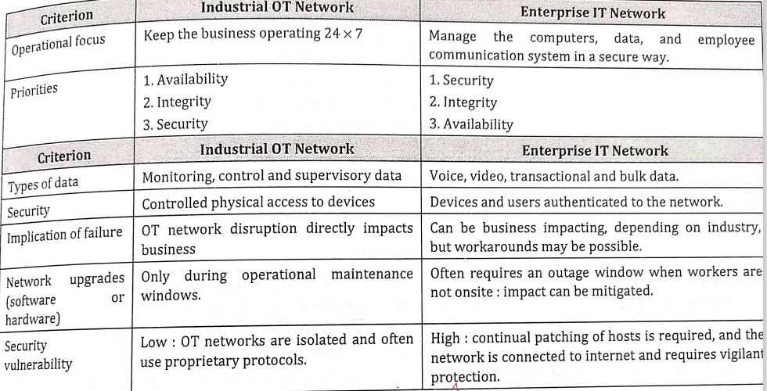
CONVERGENCE of IT and OT

